Slide 1

Forecasting Personal Savings
Ankita Gondkar
BANA 7350

Slide 2


Objectives
This project involves the creation of three distinct forecasting models for personal savings, utilizing diverse data sources and machine learning forecasting techniques.
To assess the impact of different economic factors on personal savings
It aims to pinpoint the critical factors influencing personal savings decisions.

Slide 3

DATA DESCRIPTION
Source : Federal Reserve Economic Data
Dataset:
Personal Saving, Personal Consumption Expenditure, Gross Domestic Income
Key Terms :
Personal Consumption Expenditure: Total spending by individuals on goods and services, reflecting household spending patterns.
Gross Domestic Income: Total income earned by all factors of production in an economy.

Slide 4
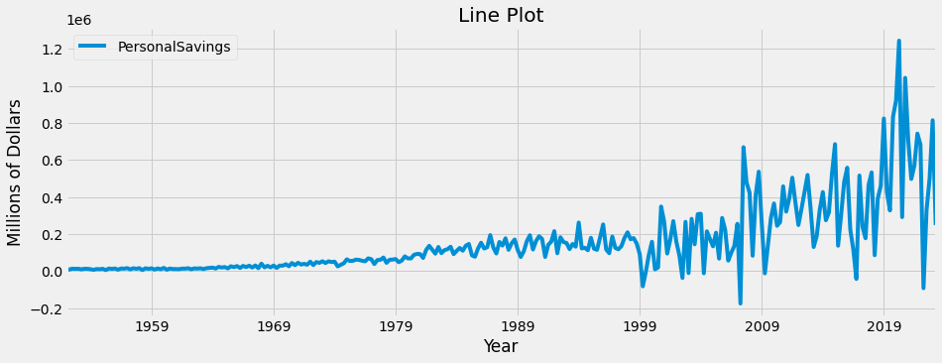
BACKGROUND
1999
The 1999 global market crash was a financial crisis caused by the collapse of the Russian ruble and the failure of LTCM, which had a significant impact on the global economy
2007–2009
The 2007-2009 personal saving downfall and rise was caused by economic recession, housing bubble collapse, and government stimulus programs.
2016
The 2016 stock market crash, high inflation, rising interest rates, geopolitical uncertainty, and recent market volatility may hinder savings by prompting shifts from stocks to alternative assets.

Slide 5
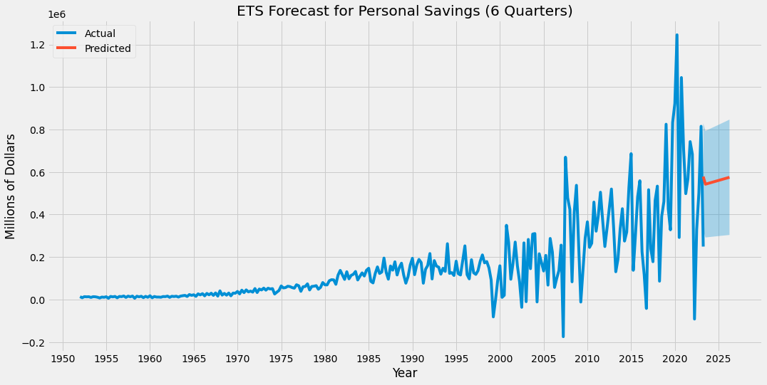
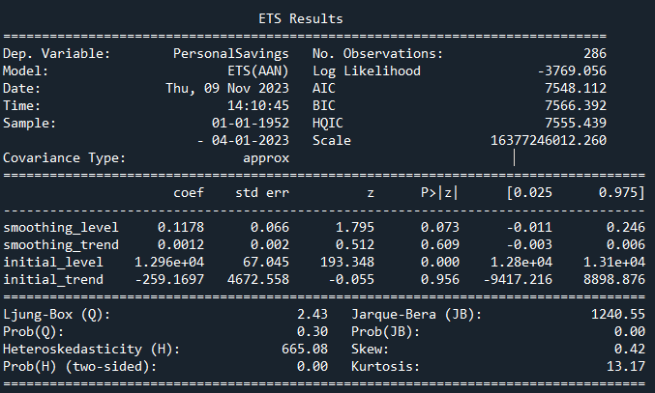
Forecasting Personal Savings using ETS (AAN)
ETS is a forecasting model that uses weighted averages of past observations to predict future values
The ETS(AAN) model found that there is a significant positive trend in personal savings. This means that personal savings are expected to continue to increase in the future.
The model also found that the trend in personal savings is not changing rapidly. This means that the rate of growth of personal savings is expected to remain relatively constant in the future.

Slide 6
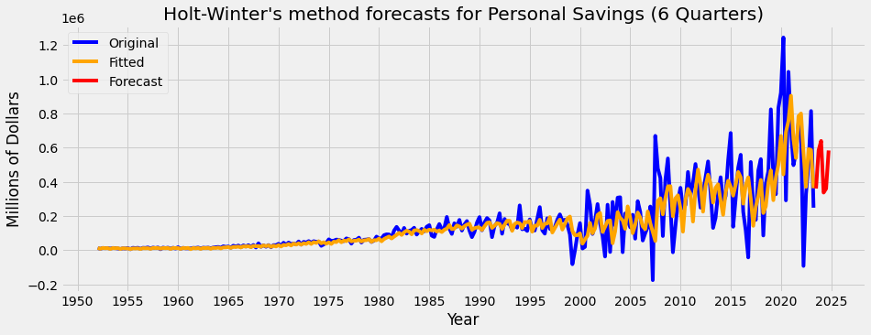
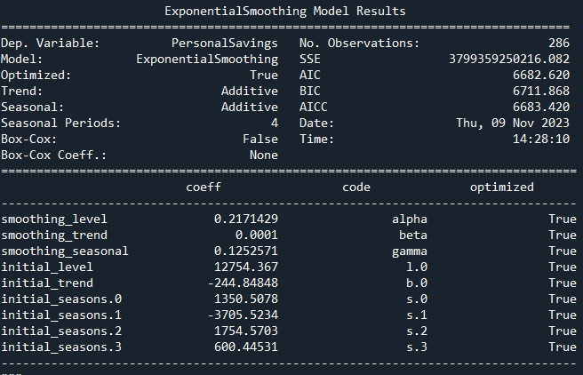
Forecasting Personal Savings using Holt-Winters
The Holt-Winters method is an exponential smoothing forecasting method for time series with trend and seasonality
The model found that there is a significant positive trend in personal savings. This means that personal savings are expected to continue to increase in the future
The model also found that there is significant seasonal variation in personal savings. This means that personal savings tend to be higher or lower during certain times of the year.

Slide 7
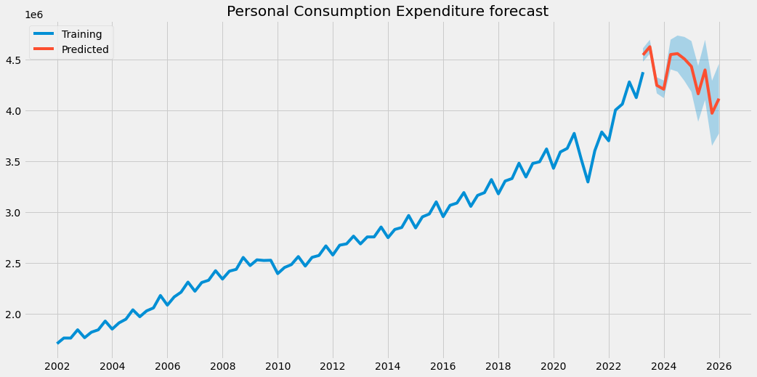
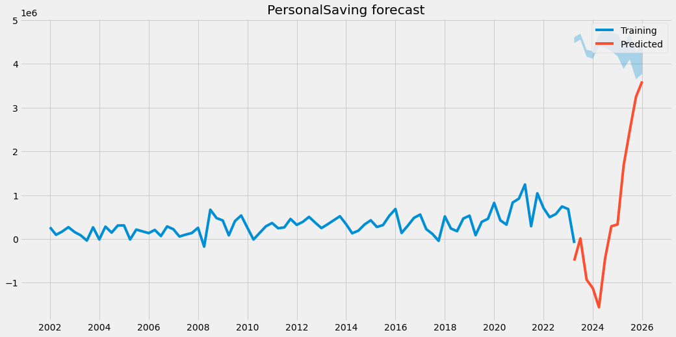
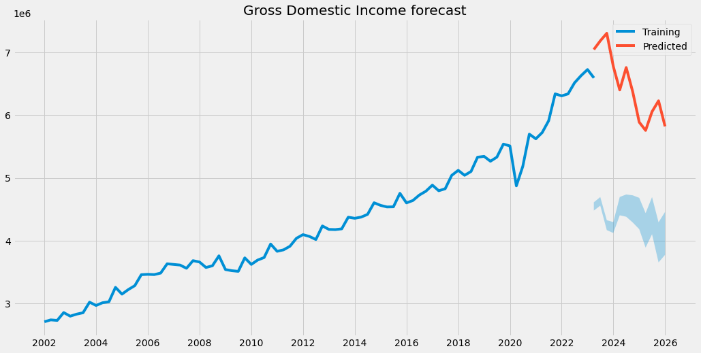
Forecasting using Vector Auto Regression
A VAR model is a multivariate forecasting model that predicts future values of a set of variables based on their past values and the past values of other variables in the set.

Slide 8
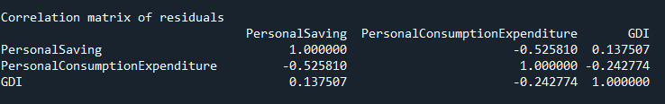
Correlation Matrix from the VAR
The negative correlation suggests an inverse relationship between Personal Saving and Personal Consumption Expenditure. When one variable increases, the other tends to decrease, and vice versa
The positive correlation indicates a weak positive relationship between Personal Saving and Gross Domestic Income. As GDI increases, there is a tendency for Personal Saving to also increase, although the correlation is not very strong
There is a negative correlation between Personal Consumption Expenditure and GDI. As Gross Domestic Income increases, there is a tendency for Personal Consumption Expenditure to decrease, and vice versa.

Slide 9

Conclusion
All three models suggest that personal savings are expected to continue to increase in the future
There is a seasonal variation in personal savings expecting the rate of growth of personal savings to remain relatively constant in the future
As GDI increases, there is a tendency for Personal Saving to also increase, although the correlation is not very strong
An individuals save more, they may spend less on consumption, and vice versa.

Slide 10

Recommendations
The strong trend in personal savings suggests that there is a growing pool of savings that could be invested in financial markets. This could lead to higher stock prices and lower bond yields.
Additionally, the fact that the trend in personal savings is not changing rapidly suggests that economic policymakers can expect personal savings to continue to provide a boost to the economy.
Individuals should continue to save for the future, as personal savings are expected to continue to grow in value.
This Photo by Unknown Author is licensed under CC BY

Slide 11


